Slide 1
Leonardo Gambacorta, Hyun Song Shin 2016
Why Bank Capital matters for Monetary Policy?
Group:
Mostafa Kamal
Nargiz Jabiyeva
Kaan Peksen
23 May, 2023

Slide 2
01
Introduction
02
Literature Review
03
Testable predictions
04
Data
Outline
05
Variables
06
Empirical Analysis
07
Critical Analysis
08
Conclusion & Findings
09
Limitations and future research directions
10

Slide 3
Introduction
Timeline of main financial events
2007: The U.S.
housing bubble bursts as the subprime mortgage market collapses.
October 3, 2008:
The U.S. government passes the Troubled Asset Relief Program (TARP)
2009: Governments
worldwide implement various measures to stabilize financial systems, including bank bailouts, stimulus packages, and regulatory reforms.
March 2015: The
asset purchase program of the European Central Bank (ECB) was implemented
1988: Basel Capital
Accord (commonly known as a Basel 1) had been introduced
2004: The BCBS
introduces Basel II, a revised framework for international banking regulations.
September 15, 2008:
Lehman Brothers, one of the largest investment banks in the U.S., files for bankruptcy
October 8, 2008: The
Federal Reserve, along with other central banks, announces coordinated interest rate cuts to ease credit conditions and restore confidence in global financial markets.
2010: In response
to the financial crisis, the BCBS introduces Basel III, an updated framework for global banking regulations.
July 2018:
The paper “Why bank capital matters for monetary policy” by L. Gambacorta and H.S. Shin got published

Slide 4
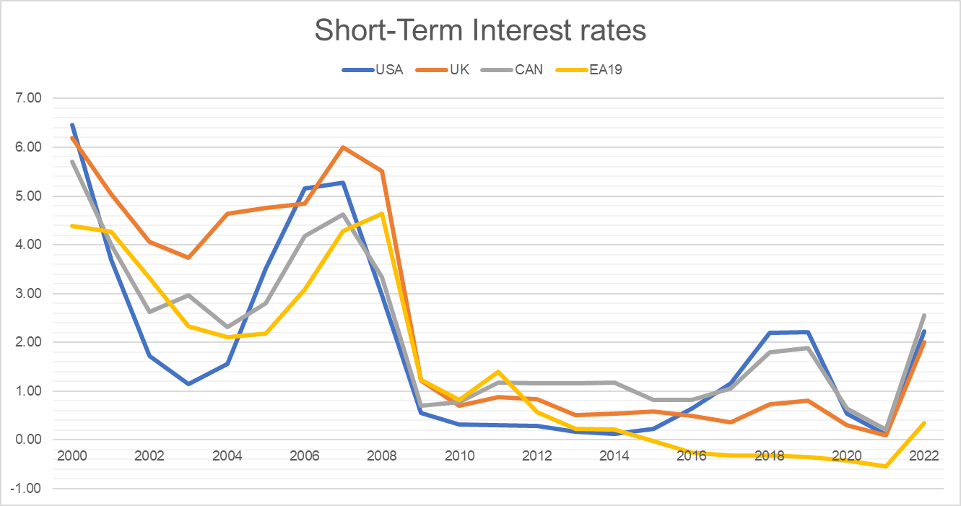
Introduction
EU19 : Austria, Belgium, Germany, Ireland, Spain, France, Italy, Luxembourg, the Netherlands, Portugal, Finland, Greece, Slovenia, Cyprus, Malta, Slovakia, Estonia, Latvia and Lithuania.
Source: OECD

Slide 5
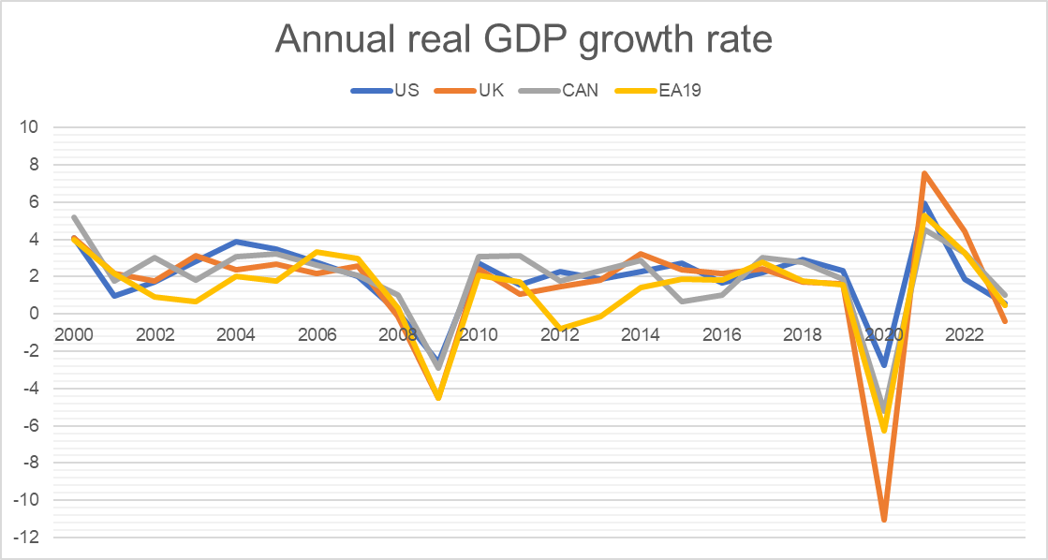
Introduction
EU19 : Belgium, Germany, Ireland, Spain, France, Italy, Luxembourg, the Netherlands, Austria, Portugal, Finland, Greece, Slovenia, Cyprus, Malta, Slovakia, Estonia, Latvia and Lithuania.
Source: OECD

Slide 6

Literature Review
The role played by the bank capital in lending that has been extensively debated for a long time, especially after the 1988 Basel Capital Accord…
The great majority of empirical literature has examined the impact of capital requirements on bank risk taking.
The effects of bank capital on lending and monetary policy took on greater prominence with the literature on the “bank lending channel”( Kashyap and Stein, (1995); Jayaratne and Morgan, (2000); Kishan and Opiela, (2000)
Van den Heuvel (2002) argues that in the presence of capital regulation when a Central Bank goes for expansionary monetary policy by reducing policy rate, banks with the binding capital requirement may not channelize those additional reserves to the private sector by extending credits.
(Kashyap and Stein 1995) notes that banks can raise funds by selling bonds, certificate of deposits (CDs) etc. in the capital market and thereby can meet the funding requirement from the market when the central bank money turns costlier.

Slide 7
Literature Review
Admati and Hellwig (2014), Ellis and Flannery (1992) support the idea that banks with adequate capital ratio can raise funds with less cost and hence could maintain high loan growth.
Altunbas, Gambacorta, and Marques-Ibanez (2010) note that banks with higher capital have a lower credit risk and hence face a lower risk premium.
Kishan and Opela (2006) found that bank capital being a buffer against losses helps the bank to raise funds with less risk premium and unlock the lending channel.
The cyclical nature of capital makes it an ‘ automatic destabilizer’ Van den Heuvel (2002)
Adrian, Boyarchenko and Shin (2010) argue that instead of extending credit during the boom phase, banks may pay out some debt liabilities (by reducing equity) to lessen the leverage. In this particular case, leverage might become countercyclical or acyclic.

Slide 8

Testable predictions
Bank Capital Channel
Bank Lending Channel
Bank equity has an elasticity of greater than one with respect to total assets.
Bank equity is positively correlated with cyclical conditions. It increases in a boom and decreases in a bust.
Less leveraged banks pay less for their debt funding.
Less leveraged banks get more debt funding.
Less leveraged banks supply more lending.
The effects of (iii)–(v) should be less pronounced (not significant) when controlling for market leverage, which is influenced by more volatile financial conditions

Slide 9
Data and stylized facts on bank capital
Data used by authors
Data used by us
BankScope
Source
Bloomberg
1994-2012
Period
1998-2022
Annual
Frequency
Annual
105
Number of Banks
26
Belgium, Canada, Switzerland, Germany, France, Italy,
Japan, the Netherlands, Sweden, the United Kingdom,
the United States, Austria, Australia and Spain
Countries
The United States, the United Kingdom, Canada and Germany
The cycle indicators
The annual growth rate of GDP and S&P 500
Annual GDP and stock market growth
Three-month interbank rates
Monetary policy measure
LIBOR rate

Slide 10
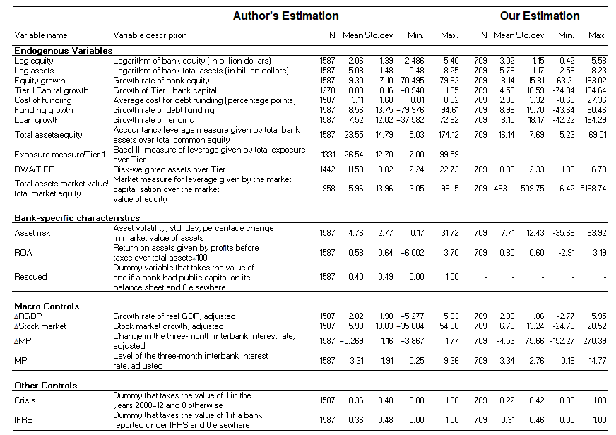
Variables

Slide 11
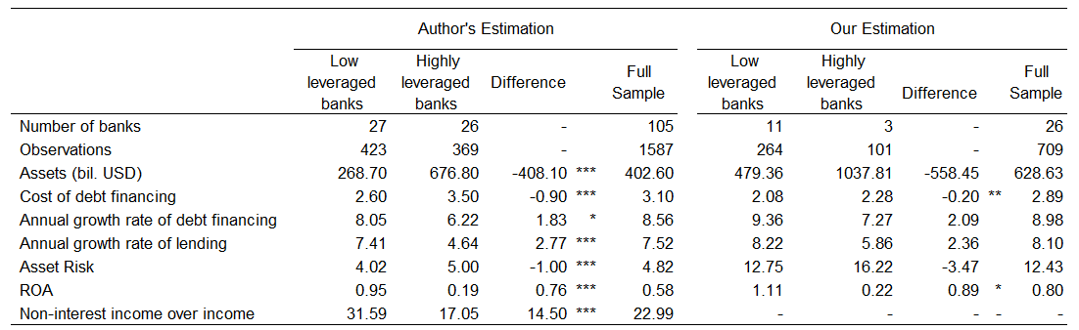
Variables

Slide 12
Empirical & Critical Analysis

Slide 13
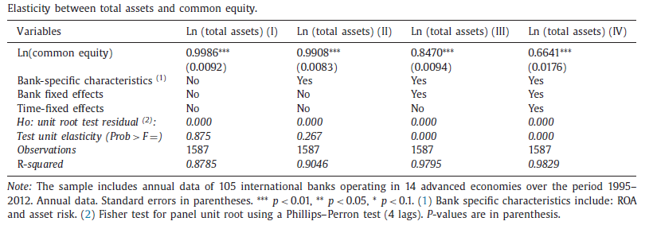
Research question & Result of authors
Elasticity of bank activity with respect to bank capital
$${Ln(Total Assets)}_{i jt}={α Ln \left(Common Equity\right)}_{i jt}+ε_{i jt}$$
${Ln(Total Assets)}_{i jt}$- the the logarithm of total asset balance sheet items
${Ln \left(Common Equity\right)}_{i jt}$ - the logarithm of total common equity in period t of bank i headquartered in country j .
Key result: There is a positive association between two variables. Modifying the specification by adding control variables doesn’t change the result, instead decreases the elasticity between two variables

Slide 14
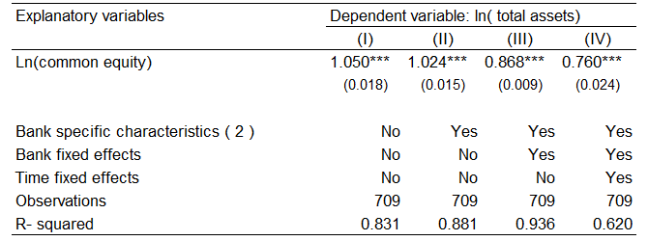
Results from our analysis
Elasticity of bank activity with respect to bank capital

Slide 15
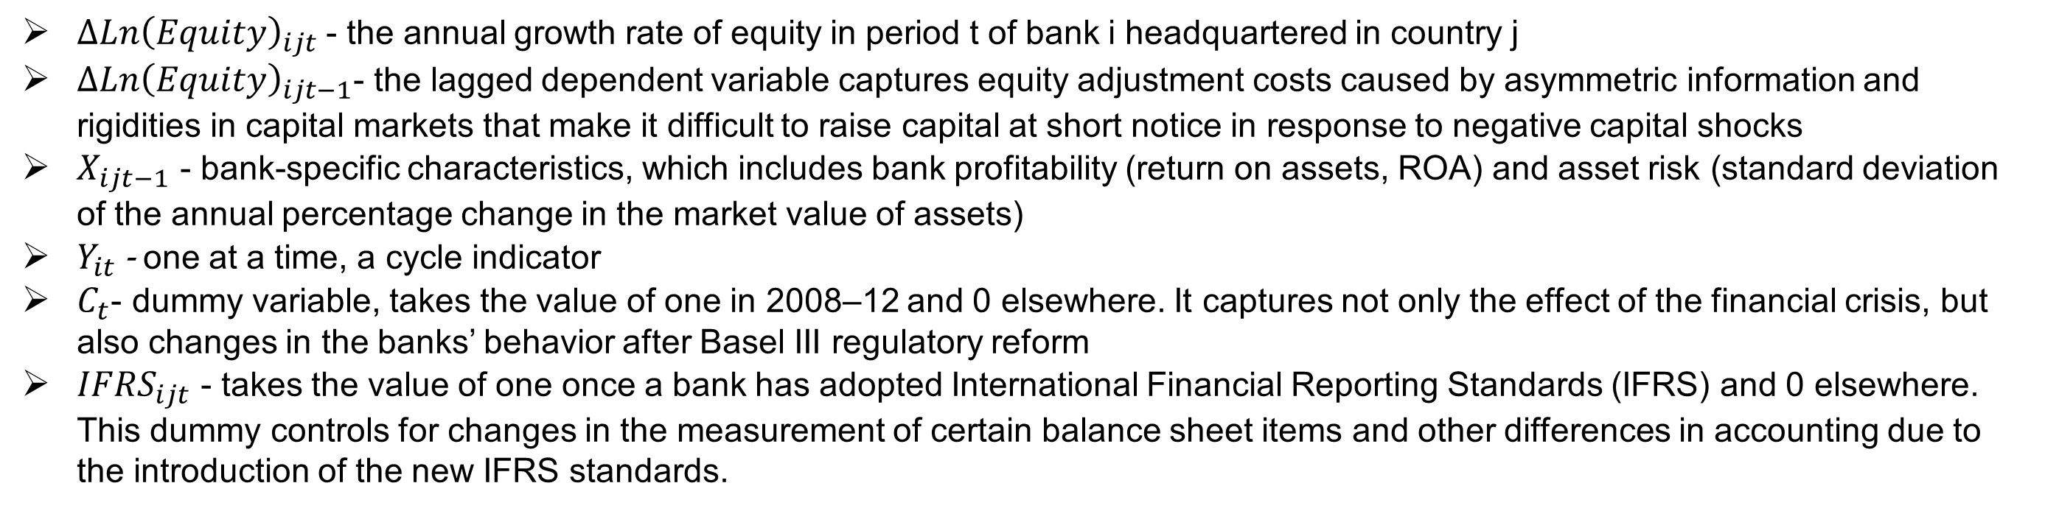
Research question
Does equity react to the cycle?
$${∆Ln\left(Equity\right)}_{ijt}={ α_{i}+β∆Ln \left(Equity\right)}_{i jt−1}+{{χY}_{it }+δX_{ijt−1}+γ{IFRS}_{ijt}+ε}_{i jt}$$
$${∆Ln\left(Equity\right)}_{ijt}={ α_{i}+φC_{t}+(β+β∗C_{t})∆Ln \left(Equity\right)}_{i jt−1}+({{χ+χ∗C_{t})Y}_{it }+(δ+δ{∗C}_{t})X_{ijt−1}+γ{IFRS}_{ijt}+ε}_{i jt}$$
${∆Ln\left(Equity\right)}_{ijt}$- the annual growth rate of equity in period t of bank i headquartered in country j
${∆Ln\left(Equity\right)}_{ijt−1}$- the lagged dependent variable captures equity adjustment costs caused by asymmetric information and rigidities in capital markets that make it difficult to raise capital at short notice in response to negative capital shocks
$X_{ijt−1}$ - bank-specific characteristics, which includes bank profitability (return on assets, ROA) and asset risk (standard deviation of the annual percentage change in the market value of assets)
$Y_{it }$- one at a time, a cycle indicator
$C_{t}$- dummy variable, takes the value of one in 2008–12 and 0 elsewhere. It captures not only the effect of the financial crisis, but also changes in the banks’ behavior after Basel III regulatory reform
${IFRS}_{ijt}$ - takes the value of one once a bank has adopted International Financial Reporting Standards (IFRS) and 0 elsewhere. This dummy controls for changes in the measurement of certain balance sheet items and other differences in accounting due to the introduction of the new IFRS standards.

Slide 16
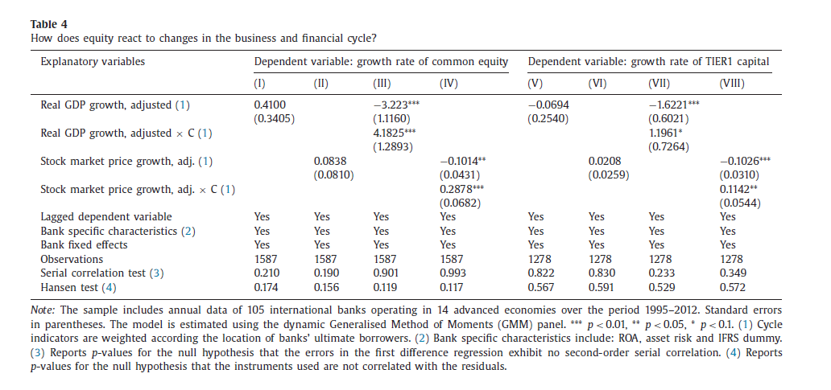
Results of authors
Does equity react to the cycle?
Key result:
The first two columns indicate that the
growth rate of equity is not correlated with the cycle indicators - the real GDP growth and stock market growth. Interestingly, the finding reported in the third and fourth columns of the table indicate that the growth rate of equity is reduced when the economy is booming and increases in a financial crisis.
These results are supported by the
findings of Muduli and Behera (2021). They find a significant negative correlation between bank equity and output gap, which supports the finding that leverage is procyclical ( Adrian and Shin, 2010, 2014; Adrian et al., 2014; Laux and Rauter, 2014 ). Adrian, Boyarchenko and Shin (2010) argue that instead of extending credit during the boom phase, banks may pay out some debt liabilities (by reducing equity) to lessen the leverage. In this particular case, leverage might become countercyclical or acyclic.
The results do not change if we use Tier
1 instead of common equity as the measure of bank capital) or changing the specification.

Slide 17
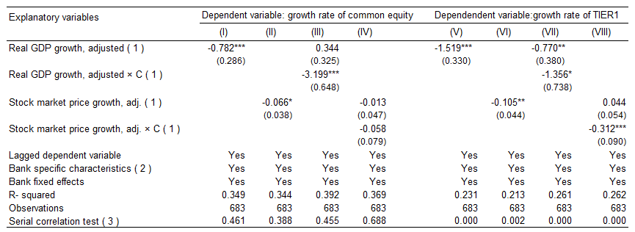
Result from our analysis
Does equity react to the cycle?
Key result: We find a significant negative correlation between growth rate of the common equity and the cycle indicators. Our results are aligned with the argument that during the recession, the capital may decline, or banks may need to keep provisions for expected future defaults (Van den Heuvel 2002).

Slide 18
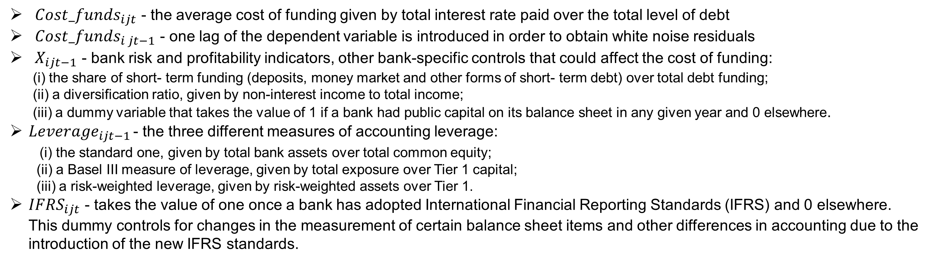
Research question
Impact of bank capitalization on funding costs
$${Cost_funds}_{ijt}={ α_{i}+θ_{t}+βCost_funds}_{i jt−1}+{{λLeverage}_{ijt−1 }+ δX_{ijt−1}+γ{IFRS}_{ijt}+ε}_{i jt}$$
${Cost_funds}_{ijt}$ - the average cost of funding given by total interest rate paid over the total level of debt
${Cost_funds}_{i jt−1}$ - one lag of the dependent variable is introduced in order to obtain white noise residuals
$X_{ijt−1}$ - bank risk and profitability indicators, other bank-specific controls that could affect the cost of funding:
(i) the share of short- term funding (deposits, money market and other forms of short- term debt) over total debt funding;
(ii) a diversification ratio, given by non-interest income to total income;
(iii) a dummy variable that takes the value of 1 if a bank had public capital on its balance sheet in any given year and 0 elsewhere.
${Leverage}_{ijt−1 }$- the three different measures of accounting leverage:
(i) the standard one, given by total bank assets over total common equity;
(ii) a Basel III measure of leverage, given by total exposure over Tier 1 capital;
(iii) a risk-weighted leverage, given by risk-weighted assets over Tier 1.
${IFRS}_{ijt}$ - takes the value of one once a bank has adopted International Financial Reporting Standards (IFRS) and 0 elsewhere. This dummy controls for changes in the measurement of certain balance sheet items and other differences in accounting due to the introduction of the new IFRS standards.

Slide 19
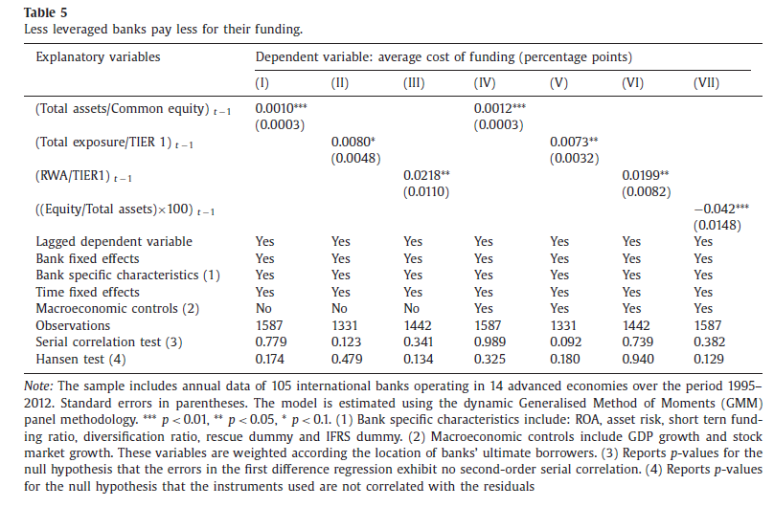
Results of authors
Impact of bank capitalization on funding costs
Key result: 1 percentage point increase in the equity-to-total-assets ratio is associated with approximately a four basis point reduction in the average cost of debt funding
Overall, the conclusion based on the sample is that a shift in the funding mix toward equity results small, and possible negligibly small change in the funding cost of the bank.

Slide 20
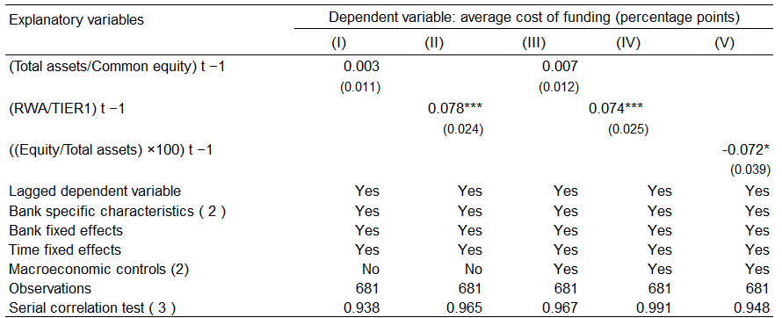
Result from our analysis
Impact of bank capitalization on funding costs
Key result: In general, the result are aligned with the findings of the authors, and they don’t change when we add the macroeconomic variables to the model.
The insignificance of the results in the first and third columns can be explained by the irrelevance of the funding mix to the overall cost of financing which was supported by Modigliani and Miller (1958).

Slide 21
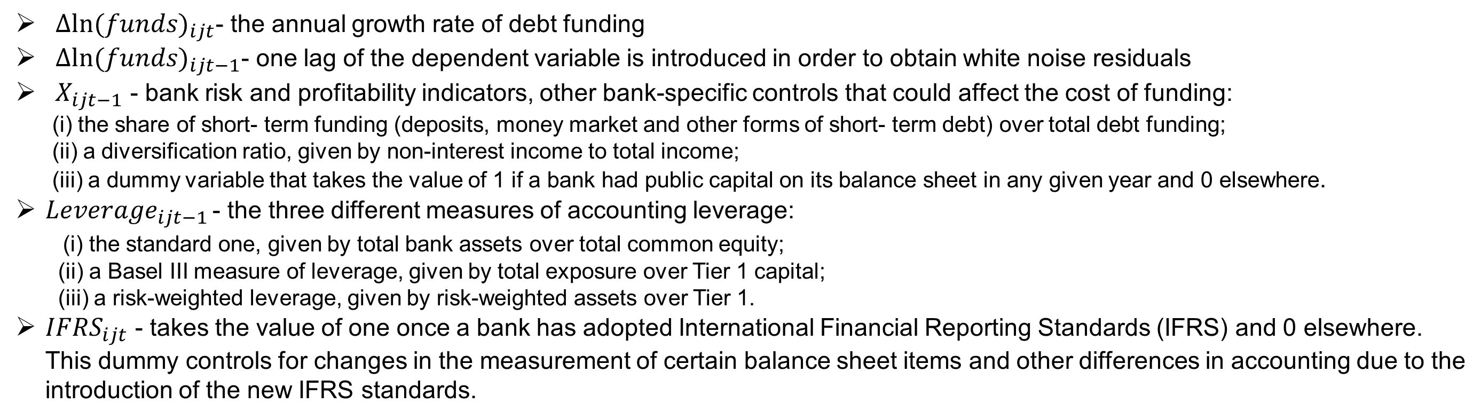
Research question
Do less leveraged banks get more funding?
$${∆ln⁡(funds)}_{ijt}={ α_{i}+θ_{t}+β∆ln⁡(funds)}_{i jt−1}+{{λLeverage}_{ijt−1 }+ δX_{ijt−1}+γ{IFRS}_{ijt}+ε}_{i jt}$$
${∆ln⁡(funds)}_{ijt}$- the annual growth rate of debt funding
${∆ln⁡(funds)}_{ijt−1}$- one lag of the dependent variable is introduced in order to obtain white noise residuals
$X_{ijt−1}$ - bank risk and profitability indicators, other bank-specific controls that could affect the cost of funding:
(i) the share of short- term funding (deposits, money market and other forms of short- term debt) over total debt funding;
(ii) a diversification ratio, given by non-interest income to total income;
(iii) a dummy variable that takes the value of 1 if a bank had public capital on its balance sheet in any given year and 0 elsewhere.
${Leverage}_{ijt−1 }$- the three different measures of accounting leverage:
(i) the standard one, given by total bank assets over total common equity;
(ii) a Basel III measure of leverage, given by total exposure over Tier 1 capital;
(iii) a risk-weighted leverage, given by risk-weighted assets over Tier 1.
${IFRS}_{ijt}$ - takes the value of one once a bank has adopted International Financial Reporting Standards (IFRS) and 0 elsewhere. This dummy controls for changes in the measurement of certain balance sheet items and other differences in accounting due to the introduction of the new IFRS standards.

Slide 22
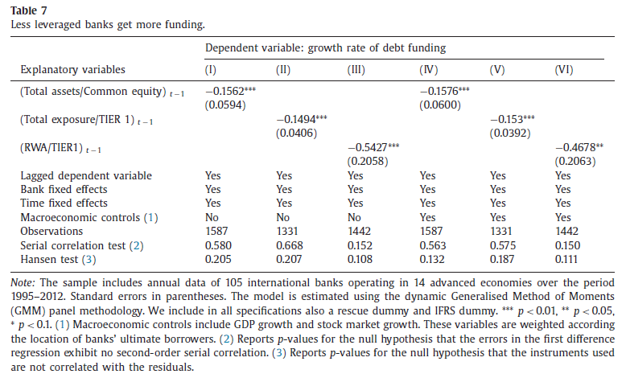
Results of authors
Do less leveraged banks get more funding?
Key result: A one standard deviation decrease in leverage determines an increase in the average annual rate of debt funding between 1.6 and 2.3%, depending on the different definitions. Results do not change if we also include in the specification a complete set of macroeconomic controls.

Slide 23
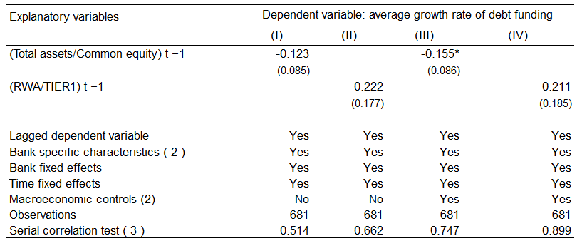
Results from our analysis
Do less leveraged banks get more funding?

Slide 24
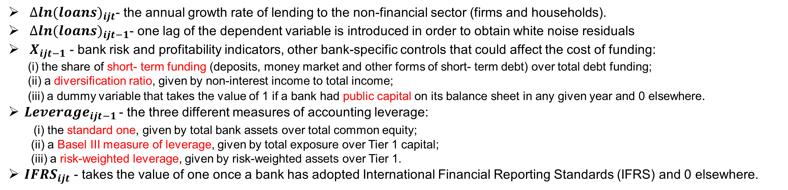
Research question
Do less leveraged banks supply more credit?
$${∆ln⁡(loans)}_{ijt}={ α_{i}+θ_{t}+β∆ln⁡(loans)}_{i jt−1}+{{λLeverage}_{ijt−1 }+ δX_{ijt−1}+γ{IFRS}_{ijt}+ε}_{i jt}$$
${∆ln⁡(loans)}_{ijt}$- the annual growth rate of lending to the non-financial sector (firms and households).
${∆ln⁡(loans)}_{ijt−1}$- one lag of the dependent variable is introduced in order to obtain white noise residuals
$X_{ijt−1}$ - bank risk and profitability indicators, other bank-specific controls that could affect the cost of funding:
(i) the share of short- term funding (deposits, money market and other forms of short- term debt) over total debt funding;
(ii) a diversification ratio, given by non-interest income to total income;
(iii) a dummy variable that takes the value of 1 if a bank had public capital on its balance sheet in any given year and 0 elsewhere.
${Leverage}_{ijt−1 }$- the three different measures of accounting leverage:
(i) the standard one, given by total bank assets over total common equity;
(ii) a Basel III measure of leverage, given by total exposure over Tier 1 capital;
(iii) a risk-weighted leverage, given by risk-weighted assets over Tier 1.
${IFRS}_{ijt}$ - takes the value of one once a bank has adopted International Financial Reporting Standards (IFRS) and 0 elsewhere.

Slide 25
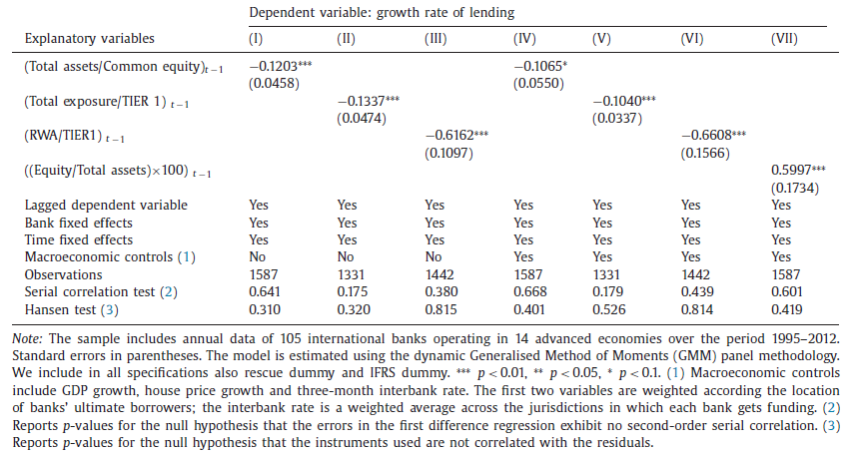
Results of authors
Do less leveraged banks supply more credit?
Key points:
Leverage is inversely associated with the changes in lending on an average
Flipping the ratio (leverage) changes the association from negative to positive (Berger and Bouwman, 2013) –higher equity in earlier period speeds up lending growth
Regulatory restriction, risk management and prudent lending (prior performance), economic conditions and credit demand

Slide 26
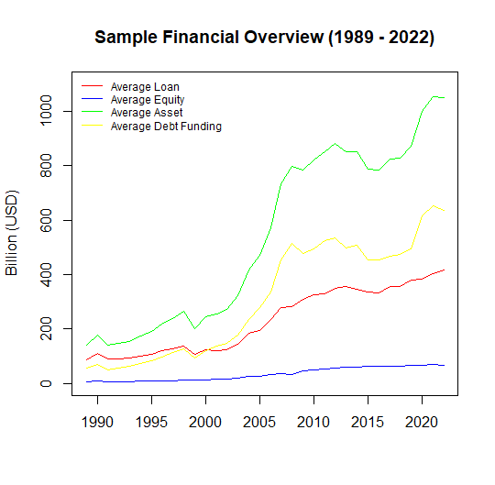
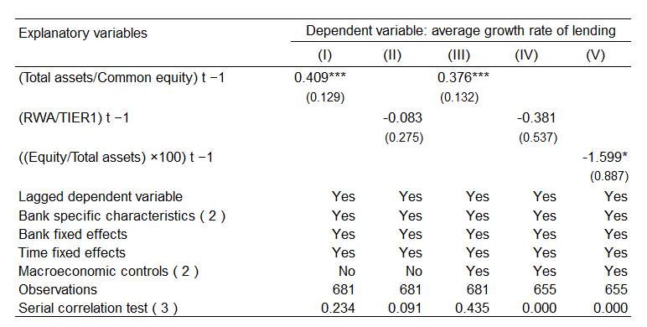
Result from our analysis
Do less leveraged banks supply more credit?
Key result:
Opposite findings– positive association (Alessi and Detken, 2018)
Why? Increased risk appetite, improved access to funding, favorable market conditions
Bank expansion ... leverage ... credit growth to financial crisis (Schularick and Taylor, 2011)

Slide 27
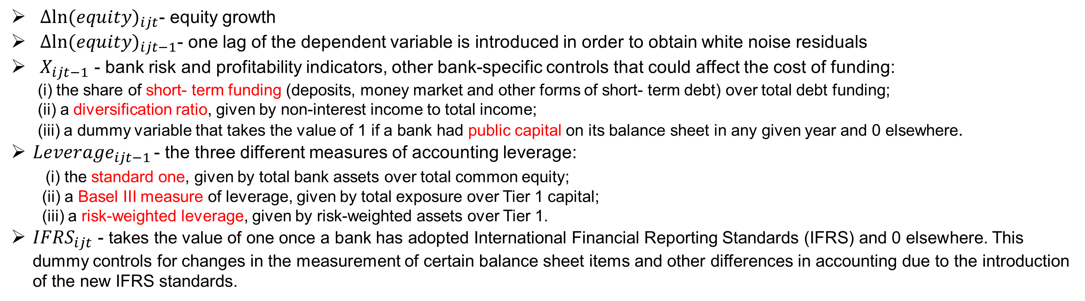
Research question
Is it a simple rebalancing effect?
$${∆ln⁡(equity)}_{ijt}={ α_{i}+θ_{t}+β∆ln⁡(equity)}_{i jt−1}+{{λLeverage}_{ijt−1 }+ δX_{ijt−1}+γ{IFRS}_{ijt}+ε}_{i jt}$$
${∆ln⁡(equity)}_{ijt}$- equity growth
${∆ln⁡(equity)}_{ijt−1}$- one lag of the dependent variable is introduced in order to obtain white noise residuals
$X_{ijt−1}$ - bank risk and profitability indicators, other bank-specific controls that could affect the cost of funding:
(i) the share of short- term funding (deposits, money market and other forms of short- term debt) over total debt funding;
(ii) a diversification ratio, given by non-interest income to total income;
(iii) a dummy variable that takes the value of 1 if a bank had public capital on its balance sheet in any given year and 0 elsewhere.
${Leverage}_{ijt−1 }$- the three different measures of accounting leverage:
(i) the standard one, given by total bank assets over total common equity;
(ii) a Basel III measure of leverage, given by total exposure over Tier 1 capital;
(iii) a risk-weighted leverage, given by risk-weighted assets over Tier 1.
${IFRS}_{ijt}$ - takes the value of one once a bank has adopted International Financial Reporting Standards (IFRS) and 0 elsewhere. This dummy controls for changes in the measurement of certain balance sheet items and other differences in accounting due to the introduction of the new IFRS standards.
Key result:
The results indicate that there is no significant link between leverage in t −1 and the growth of equity in t ( λ≈0) (not reported in the paper)

Slide 28
Result from our analysis
Do less leveraged banks concerns about equity growth?
Key result:
Opposite findings– earlier leverage affects equity growth –aligned with (Cohen and Scatigna, 2014 )
Increased profitability, capital accumulation, or successful investment strategies
Lagged equity to asset ratio associates negatively with equity growth
Conservative capital structure approach (lower level of debt funding), and financial constraints –less investment

Slide 29
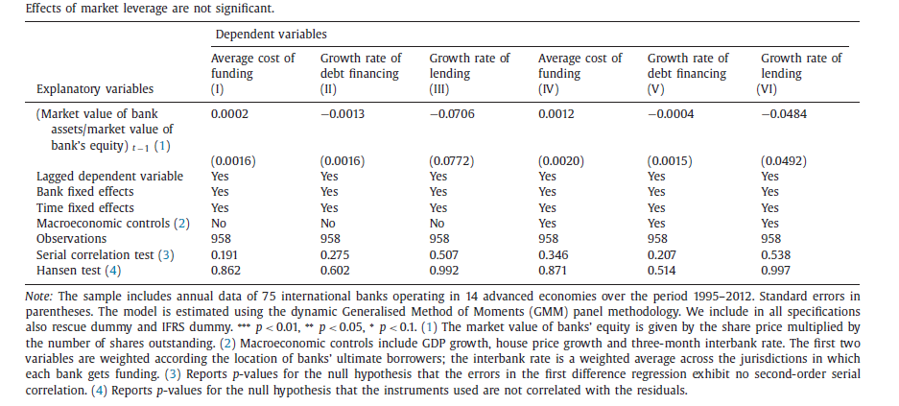
Research question and result
Market leverage vs accounting leverage
Since the market values of assets and equity tend to be more volatile than book values, could a market measure of leverage have a different impact (with respect to an accounting measure) on the cost and quantity of bank funding and on overall bank lending?
Key result:
The main finding is that a market measure is not statistically significant, as opposed to the accounting measures of the leverage ratio. Results do not change if we also include in the specification a complete set of macroeconomic controls.

Slide 30
Results from our analysis
Market leverage vs accounting leverage
Key result:
Same as author’s findings! Even after controlling the macro variables.

Slide 31
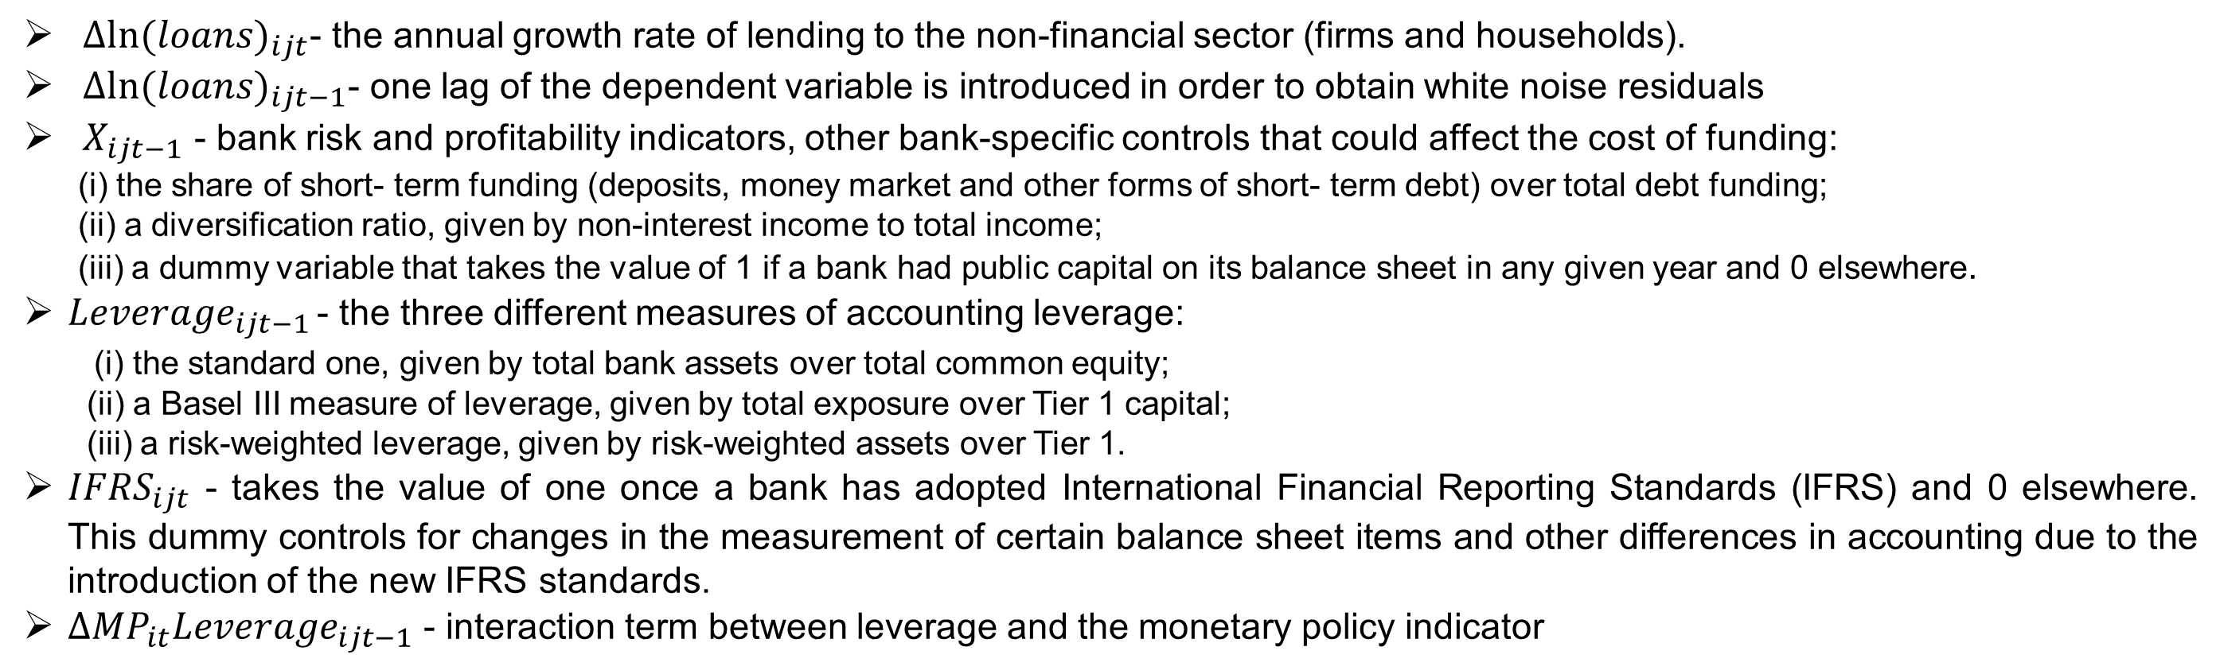
Research questions
The effect of bank capital in the monetary transmission mechanism
$${∆ln⁡(loans)}_{ijt}={ α_{i}+θ_{t}+β∆ln⁡(loans)}_{i jt−1}+{{λLeverage}_{ijt−1 }+{κ∆MP}_{it}{Leverage}_{ijt−1}+ δX_{ijt−1}+γ{IFRS}_{ijt}+ε}_{i jt}$$
${∆ln⁡(loans)}_{ijt}$- the annual growth rate of lending to the non-financial sector (firms and households).
${∆ln⁡(loans)}_{ijt−1}$- one lag of the dependent variable is introduced in order to obtain white noise residuals
$X_{ijt−1}$ - bank risk and profitability indicators, other bank-specific controls that could affect the cost of funding:
(i) the share of short- term funding (deposits, money market and other forms of short- term debt) over total debt funding;
(ii) a diversification ratio, given by non-interest income to total income;
(iii) a dummy variable that takes the value of 1 if a bank had public capital on its balance sheet in any given year and 0 elsewhere.
${Leverage}_{ijt−1 }$- the three different measures of accounting leverage:
(i) the standard one, given by total bank assets over total common equity;
(ii) a Basel III measure of leverage, given by total exposure over Tier 1 capital;
(iii) a risk-weighted leverage, given by risk-weighted assets over Tier 1.
${IFRS}_{ijt}$ - takes the value of one once a bank has adopted International Financial Reporting Standards (IFRS) and 0 elsewhere. This dummy controls for changes in the measurement of certain balance sheet items and other differences in accounting due to the introduction of the new IFRS standards.
${∆MP}_{it}{Leverage}_{ijt−1}$ - interaction term between leverage and the monetary policy indicator

Slide 32
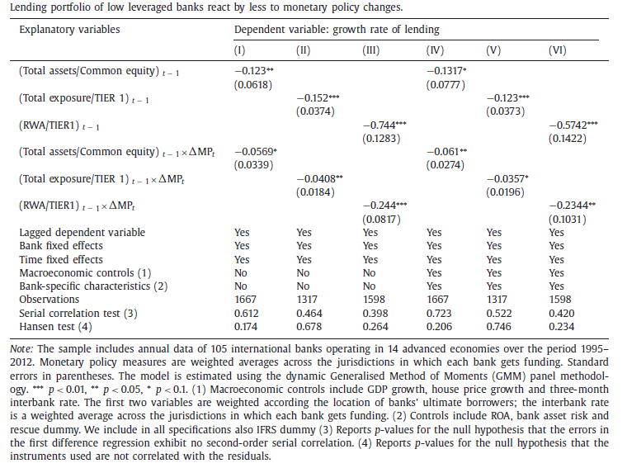
Results of authors
The effect of bank capital in the monetary transmission mechanism
Key result:
The effects of a monetary tightening are smaller for banks with higher capitalization, which have easier access to uninsured financing.
Italian banks (Gambacorta and Mistrulli, 2004) ;
Spanish banks (Jiménez et al., 2012a)
Increasing rates –negatively associates the bank lending

Slide 33
Results from our analysis
The effect of bank capital in the monetary transmission mechanism
Possible reasons:
Increased financial risk
Reduced liquidity, or
Tighter credit conditions
Low-capitalised banks are therefore more exposed to asymmetric information problems and have less capacity to shield their credit relationships (Jayaratne and Morgan, 2000; Kishan and Opiela, 2000 ).
Key result:
Combined effects of lagged leverage ratio and 3-month interbank lending rate (LIBOR) on lending growth –negative!
Same as authors’ findings (standard leverage)

Slide 34
Conclusion
& Findings

Slide 35

Summary of the findings
Authors’
Ours
VS
1
Bank equity has an elasticity of greater than one with respect to total assets
True
True
2
Opposite is True
Bank equity is positively correlated with cyclical conditions. It increases in a boom and decreases in a bust
True
3
True
Not necessarily (MP matters)
Less leveraged banks pay less for their debt funding
4
True
Opposite is True
Less leveraged banks get more debt funding
5
Not necessarily (efficiency)
Less leveraged banks supply more lending
True
5
The effects of (3)–(5) should be less pronounced (not significant) when controlling for market leverage, which is influenced by more volatile financial conditions
True
True

Slide 36




Limitations and Future Research directions
Small sample size and centric to the USA, Canada, UK and Germany
Didn’t adjust merger and acquisition
Public recapitalization during crisis moments
Linear interpolation to predict the missing values
Only GFC is considered as the financial crisis effects where data range covers Dotcom bubble (2001), GFC (2008-10), ESDC (2010-12), and COVID-19 (2020-2021)
Countercyclical buffering for each country (country specific risk)
Tier 1 capital requirement stays same but CCYB changes overtime
Considering cross banks interactions
Risk taking behaviors (NPL/loan ratio)
Sectoral and industrial consideration of banks
Monetary policy tracking -QE/QT
Bank rating
Systemic and non-or-mild systemic classifications
Data range and diversified samples (e.g., emerging markets)

Slide 37
Thank you!
Any questions?

Slide 38
References

